Slide 1
ENERGY INVENTORY

Slide 2
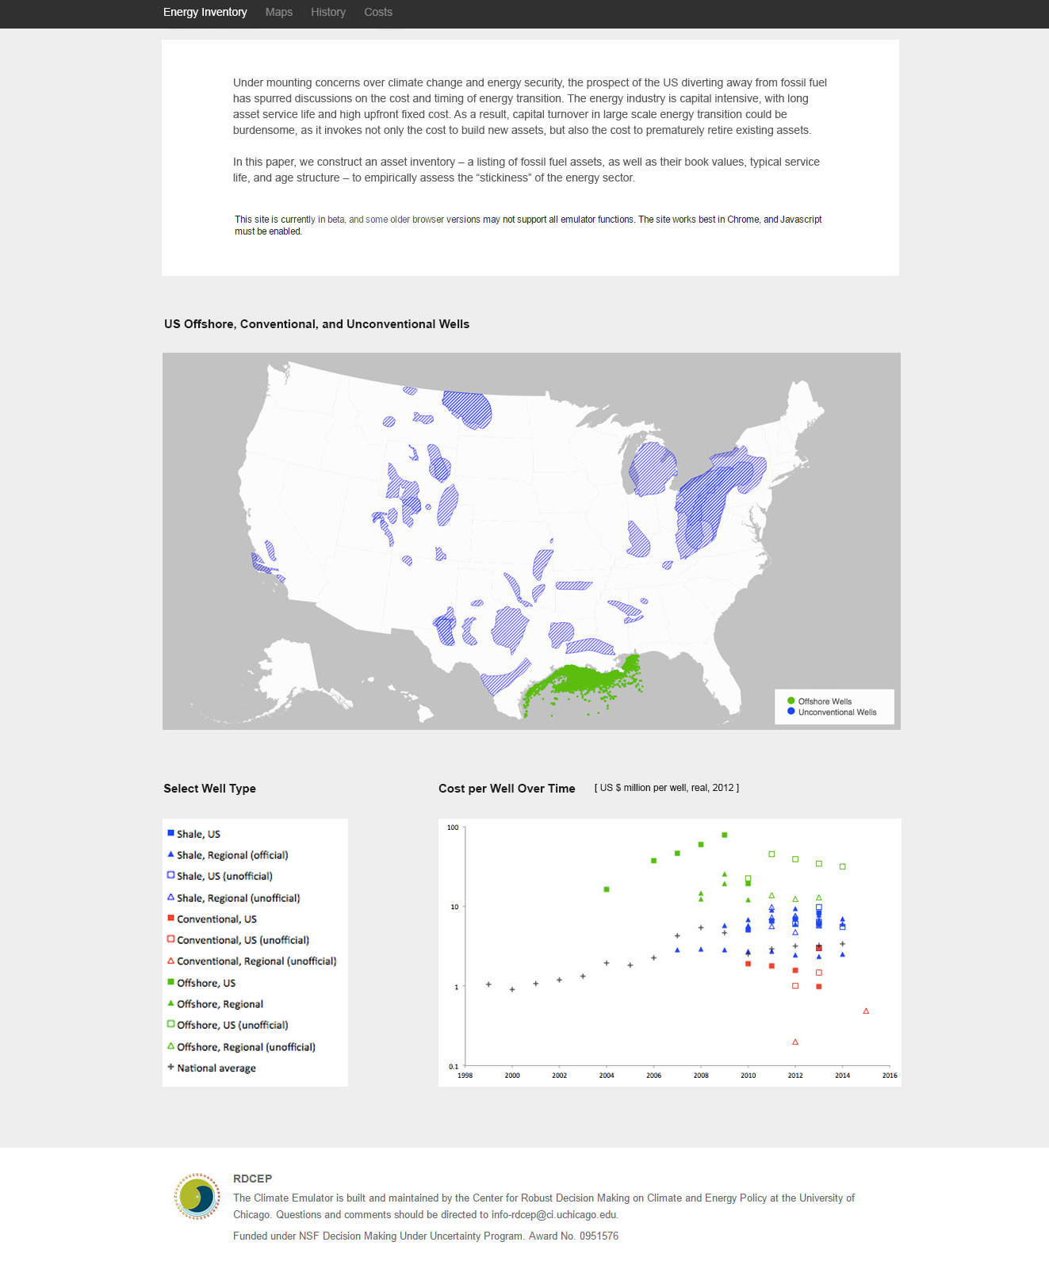
ENERGY INVENTORY SITE:
Data will be online and interactive. Users can explore costs, geographic distribution, and age of specific power infrastructures.
Site sections will include maps (users can select various layers and elements), history (including supply chain diagrams), and interactive cost graphs.
Maps will include tooltips – for example, clicking on a coal mine will display a tab with information on mine production volume and planned retirement date.

Slide 3
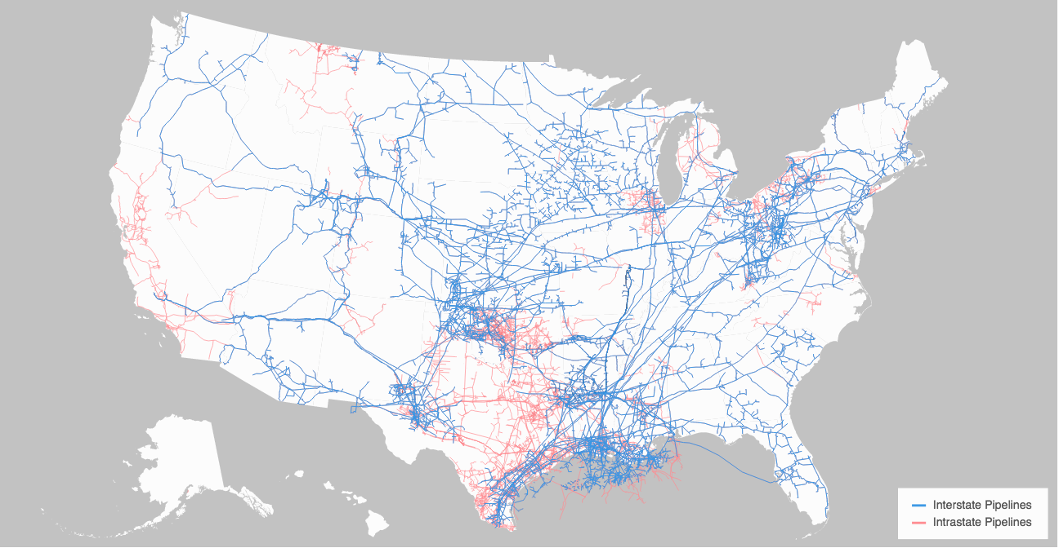
US NATURAL GAS PIPELINES
Maps were created using d3 and geojson file formatting. Map data is from the US Energy Information Administration. Legends utilize Susie Lu’s d3-legends library and map textures are from Riccardo Scalco’s Textures.js library.

Slide 4
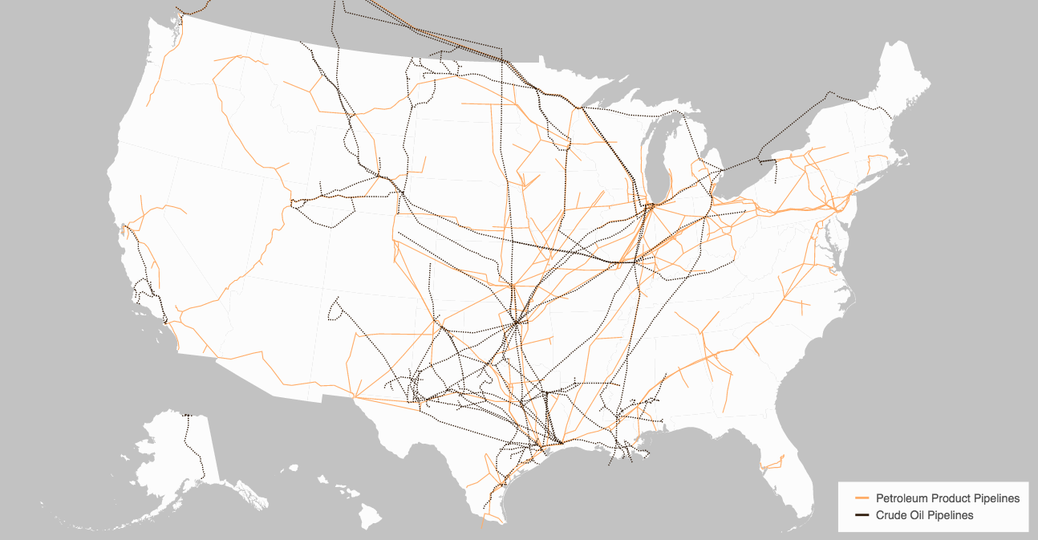
US CRUDE OIL AND PRODUCT PIPELINES:
Source: Energy Information Administration, Office

Slide 5
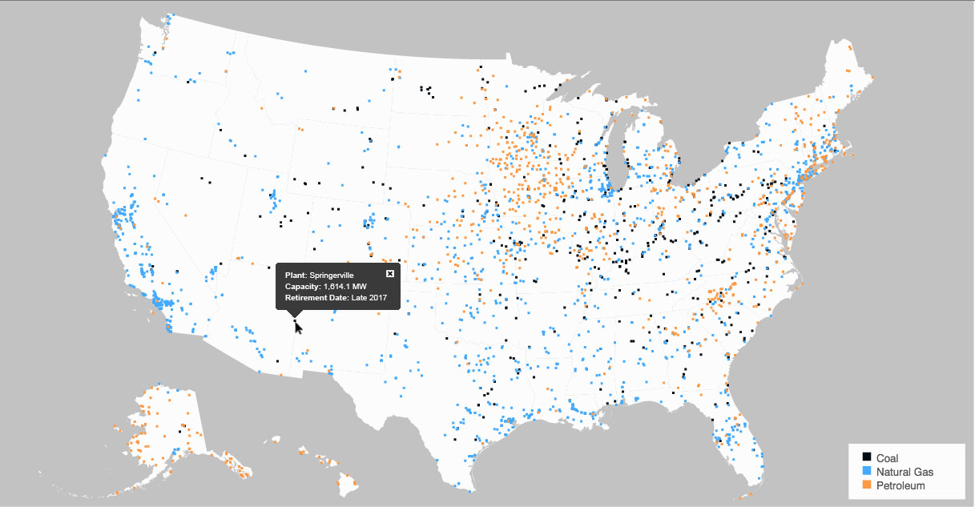
US POWER PLANTS (OIL, GAS, and COAL):
Source: Energy Information Administration, Office

Slide 6
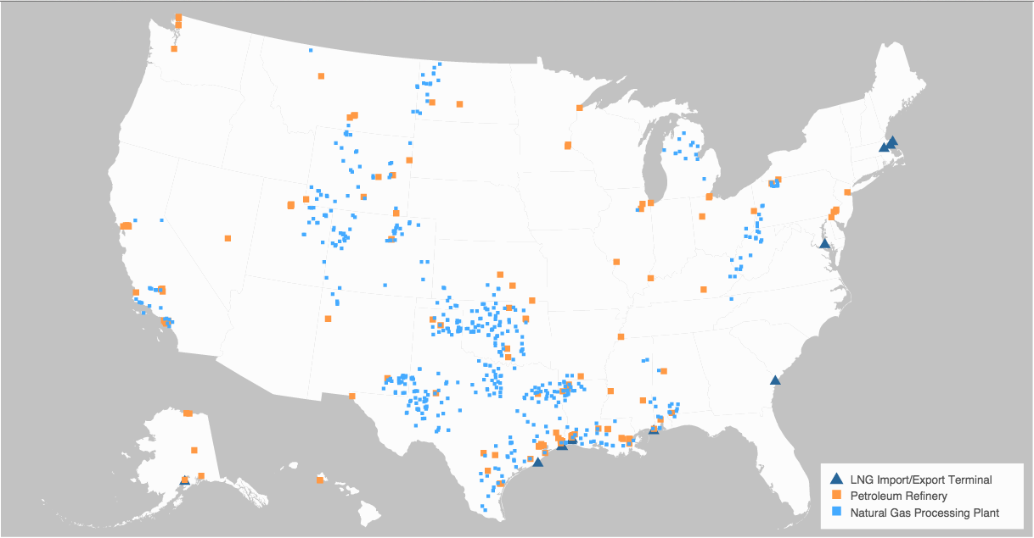
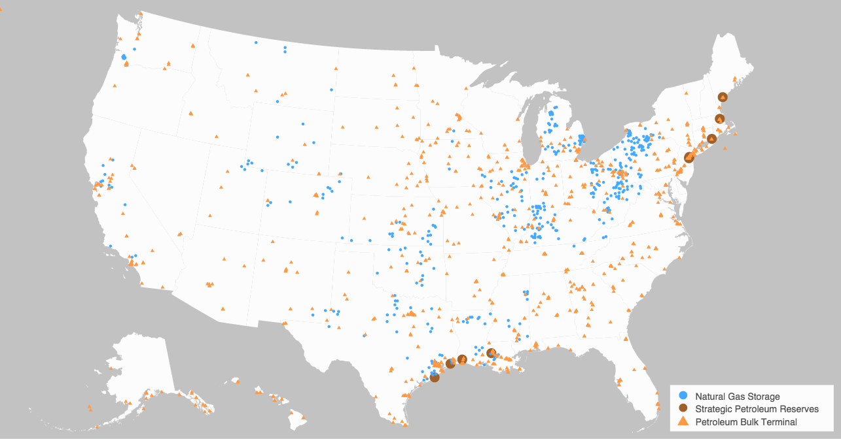
LIQUID NATURAL GAS TERMINALS, NATURAL GAS PROCESSING, and PETROLEUM REFINERIES:
OIL AND GAS STORAGE:

Slide 7
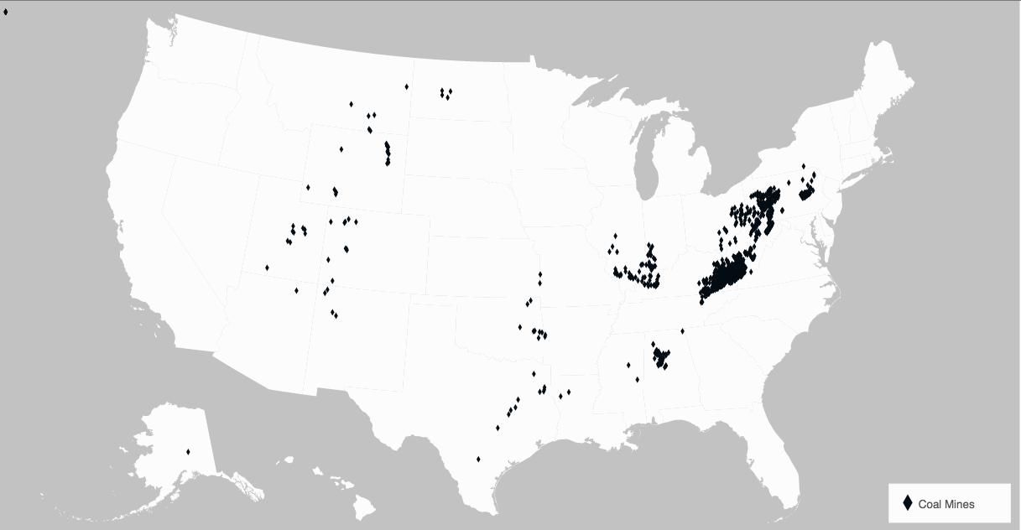
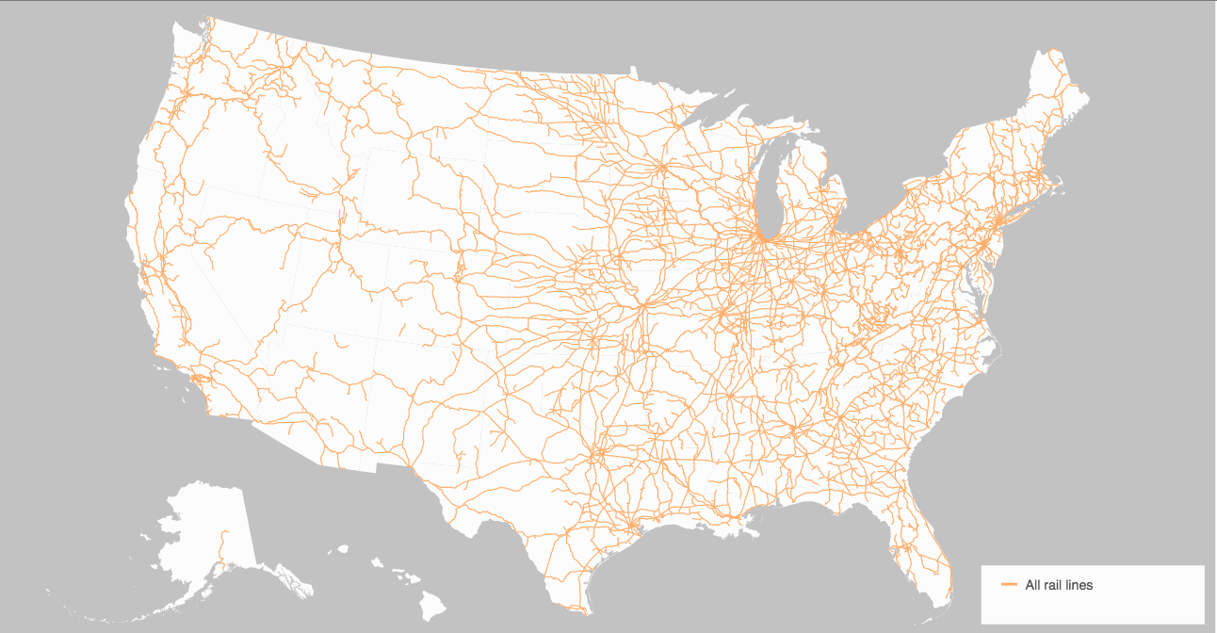
COAL EXTRACTION:
ALL US RAIL (will be COAL TRANSPORTATION):

